Slide 1
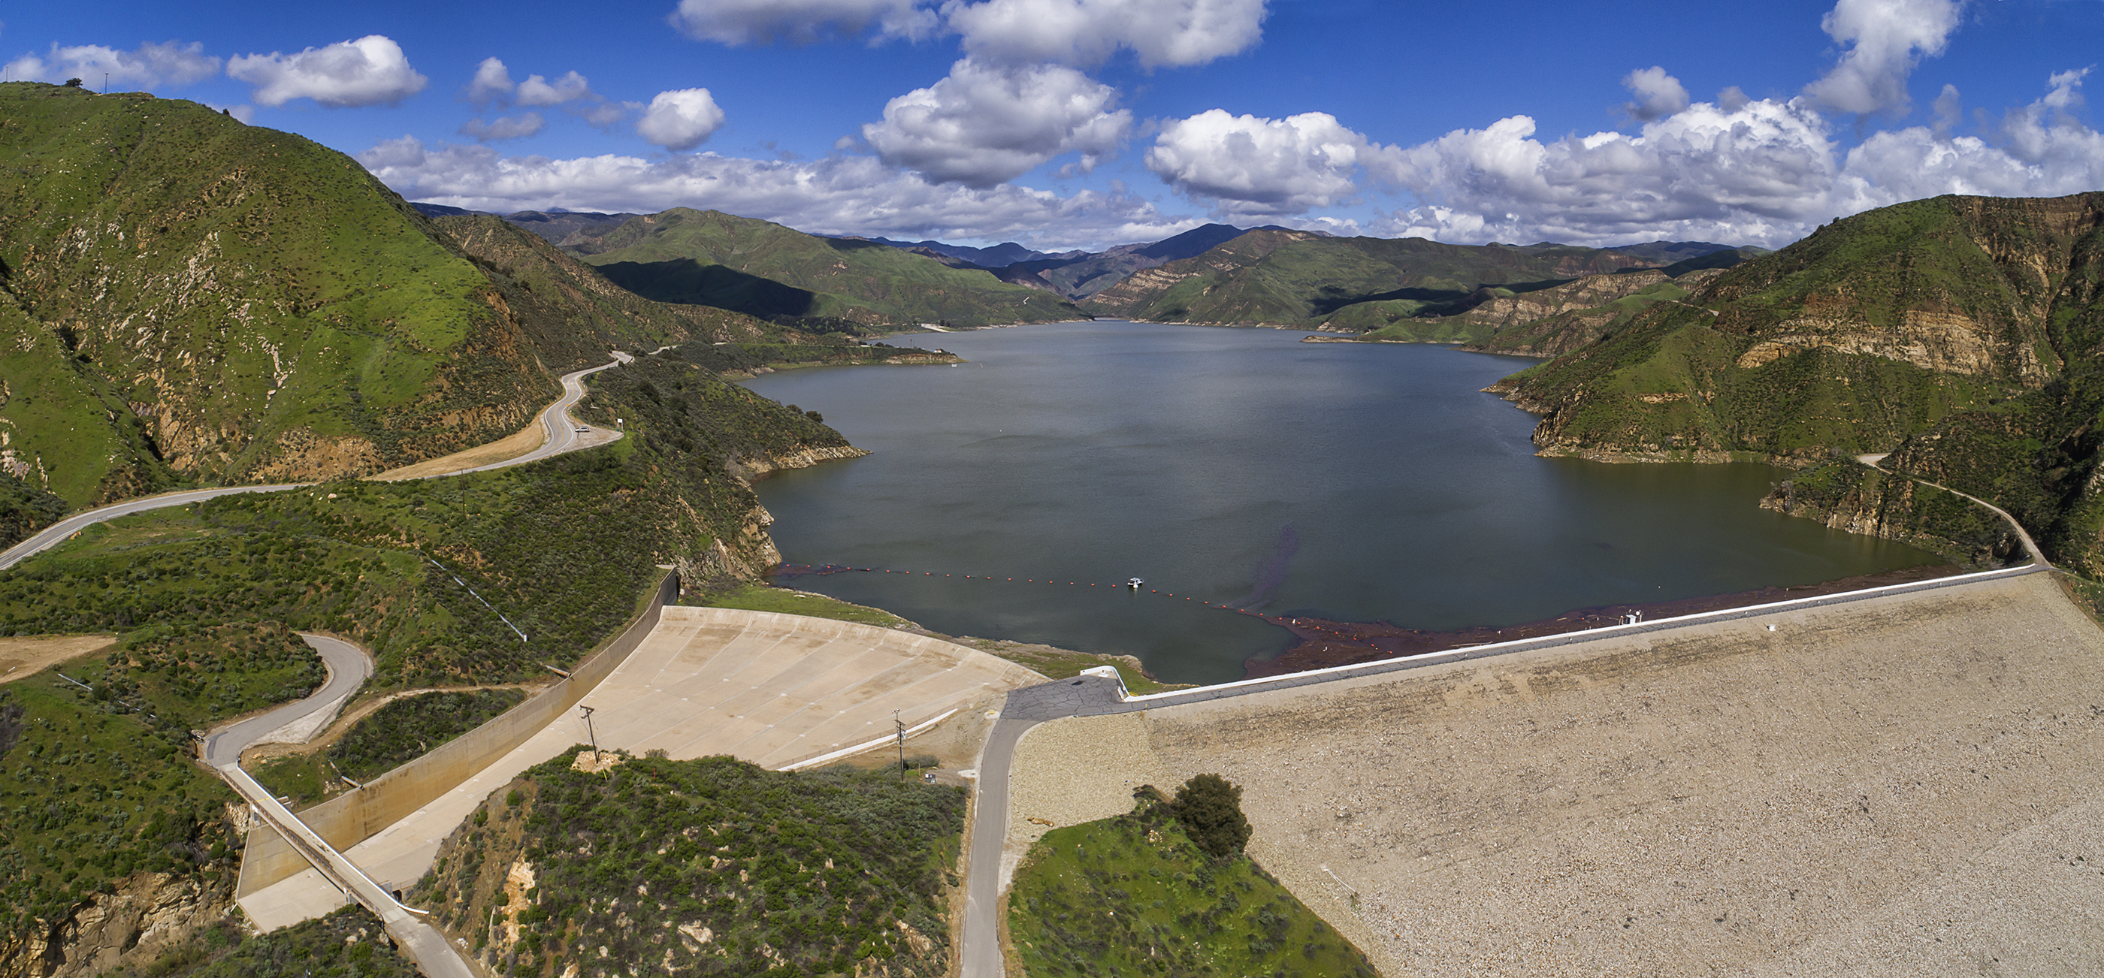
2019 District Conditions Update
(Fillmore and Piru GSA)

Slide 2
Rain Gages in Ventura County
Lake Piru
Rainfall Comparison

Slide 3
Top 30% in terms precipitation

Slide 4
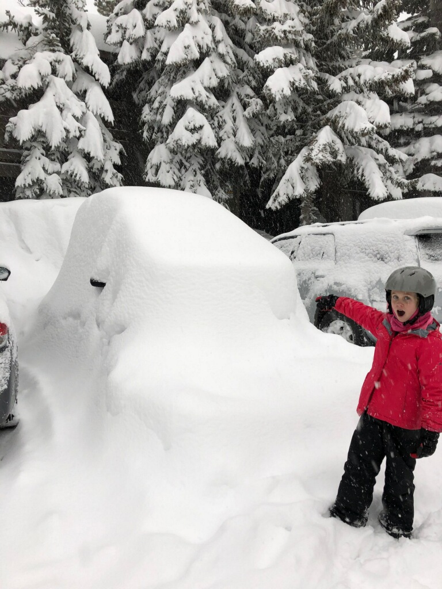
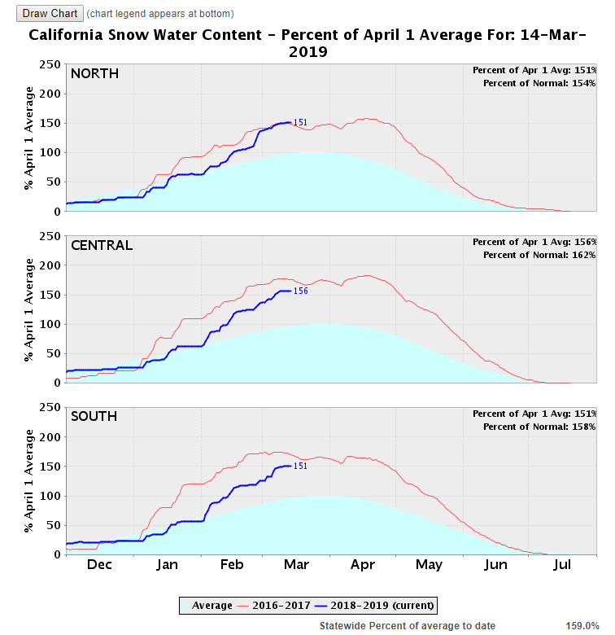

Slide 6
3.5 in. rain with Article 21 Water
3 in. rain
6 in. rain
7.6 in. rainfall
3.7 in. rainfall

Slide 7
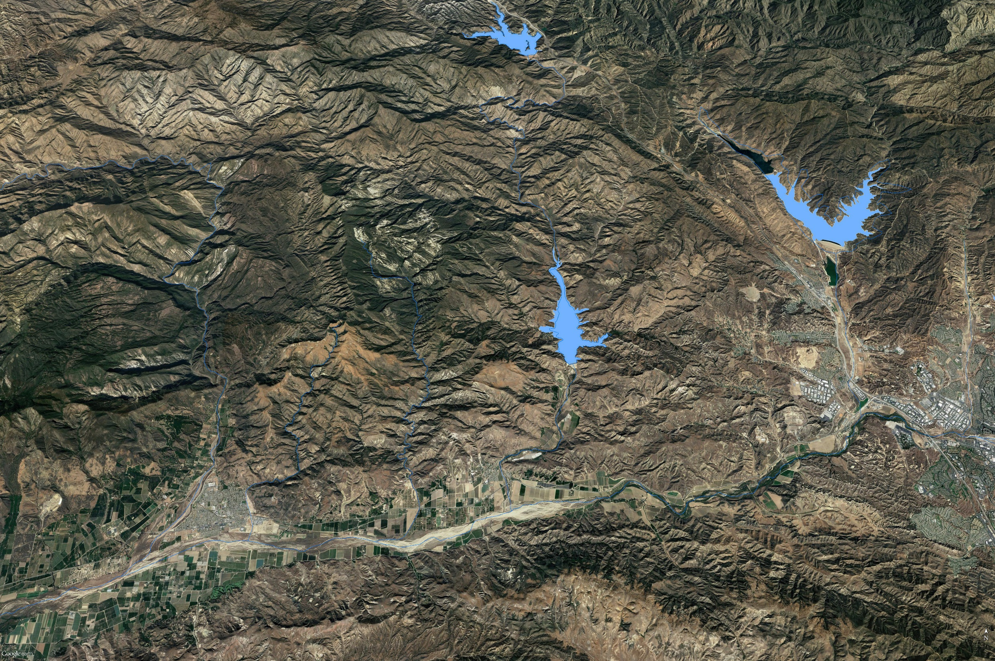
Pyramid Lake
Article 21 Release to Lake Piru
Date | Total Available (AF) | Requested by United (AF) | Allocated to United (AF) | Release rate (CFS)
Feb. 19-Feb 26 | 23,802 | 15,000 | 145 | 9
Feb. 27-March 5 | 40,661 | 15,000 | 87 | 5
March 1- 5 adj. | 53,554 | 15,000 | 10,752 | 1,080
March 6-12 | 90,247 | 4,103 | 4,103 | 296
March 13-19 | 68,032 | 0 | 0 | 0
March 20-26 | 55,500 | 0 | 0 | 0
From March 1 to March 26 the East Branch conveyance was limited in its capacity so all requests were met in the West Branch
Castaic Lake
Lake Piru

Slide 8
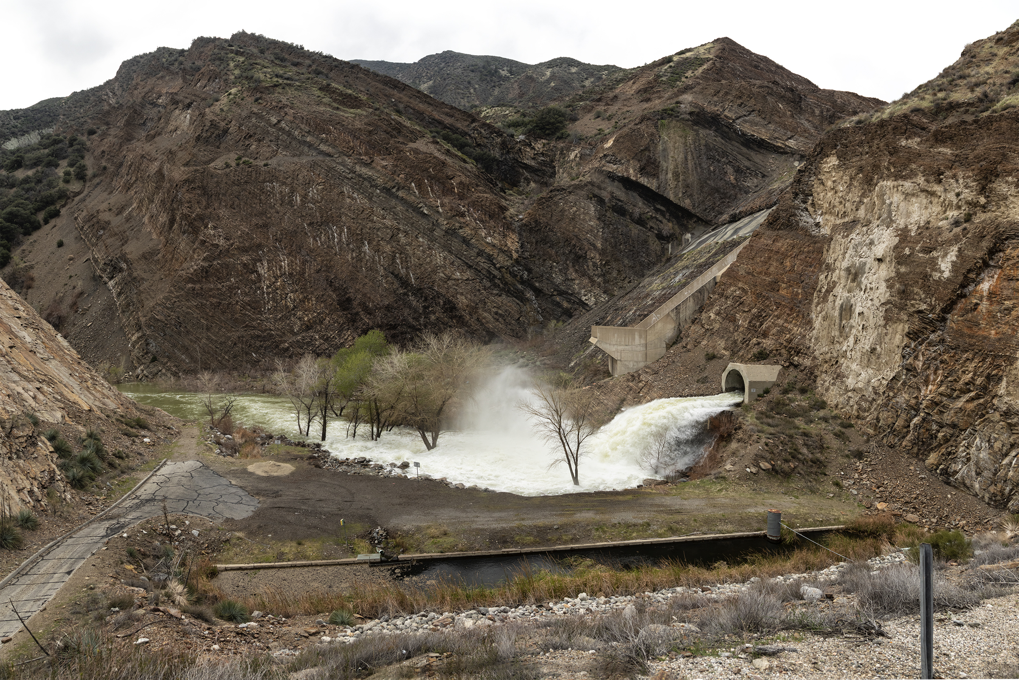
Release of 1,080 cfs of Article 21 water

Slide 9
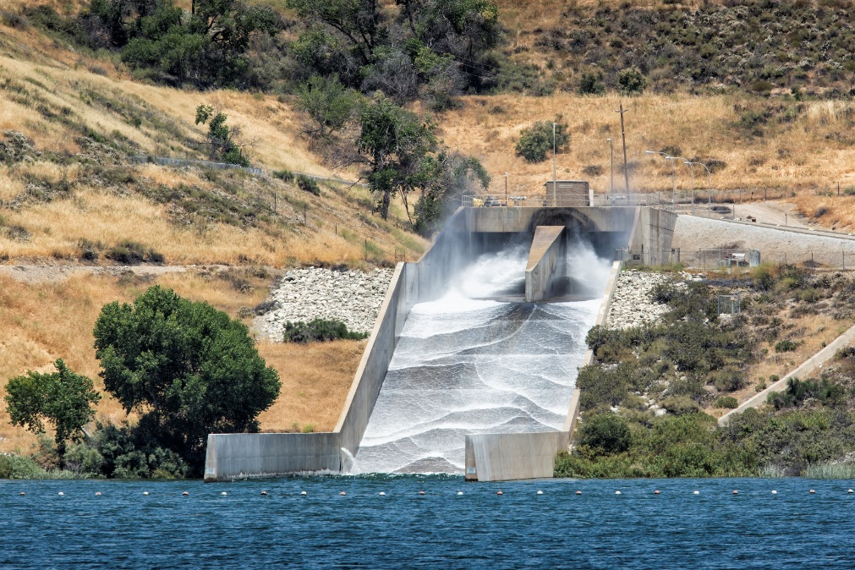
Flood flows from Castaic Creek
Approximately 13,000 AF Stored
Pyramid Lake
Castaic Lake
Lake Piru
Release of 100 to 150 cfs
From March 14 to May 1

Slide 10
Summary of Releases this year
Pyramid Lake
Castaic Lake
Lake Piru
15,000 AF of Article 21 water
2,200 AF of State Water
24,000-30,000 of Natural Runoff
Castaic Release 13,000 AF
Total Potential Release from
Both reservoirs: 60,000 AF

Slide 11
Piru Creek Confluent (June 15)
Piru Creek
SCR

Slide 12
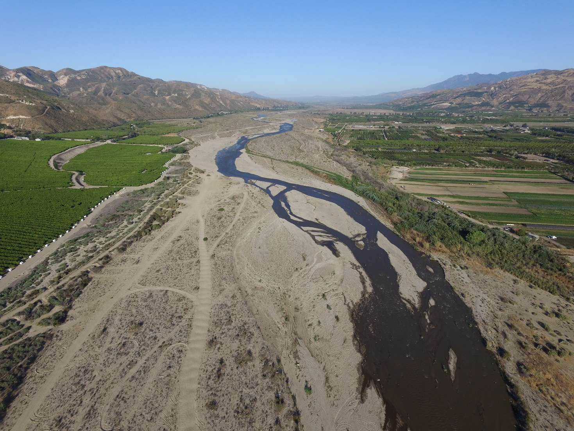
Santa Clara River at Torrey
May 30
June 15

Slide 13
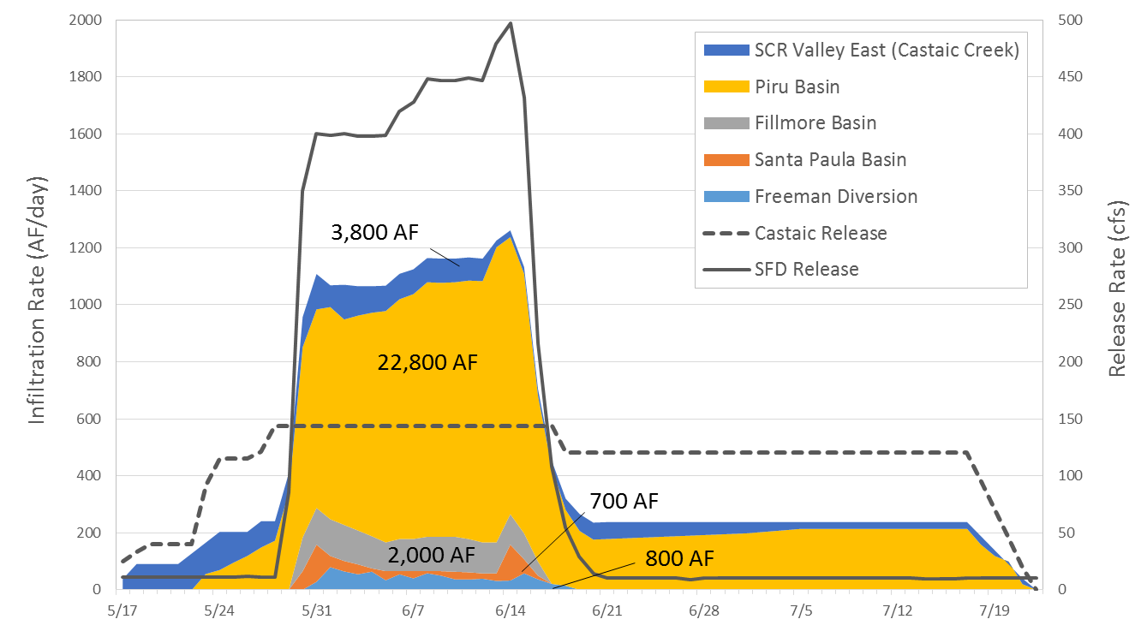
Direct Benefits to Groundwater Basins

Slide 14
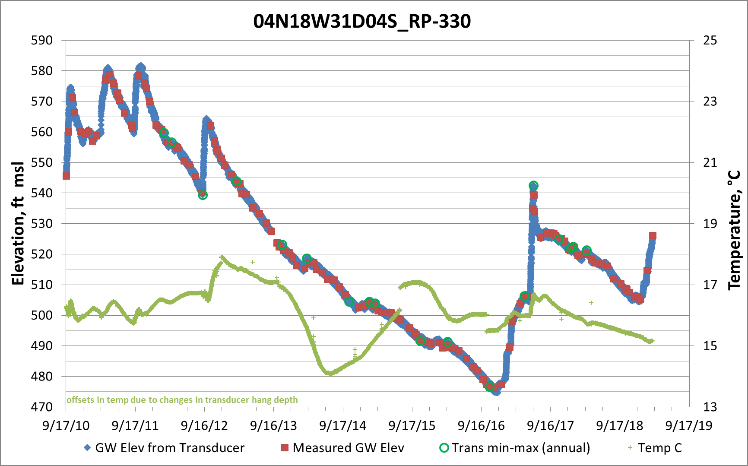
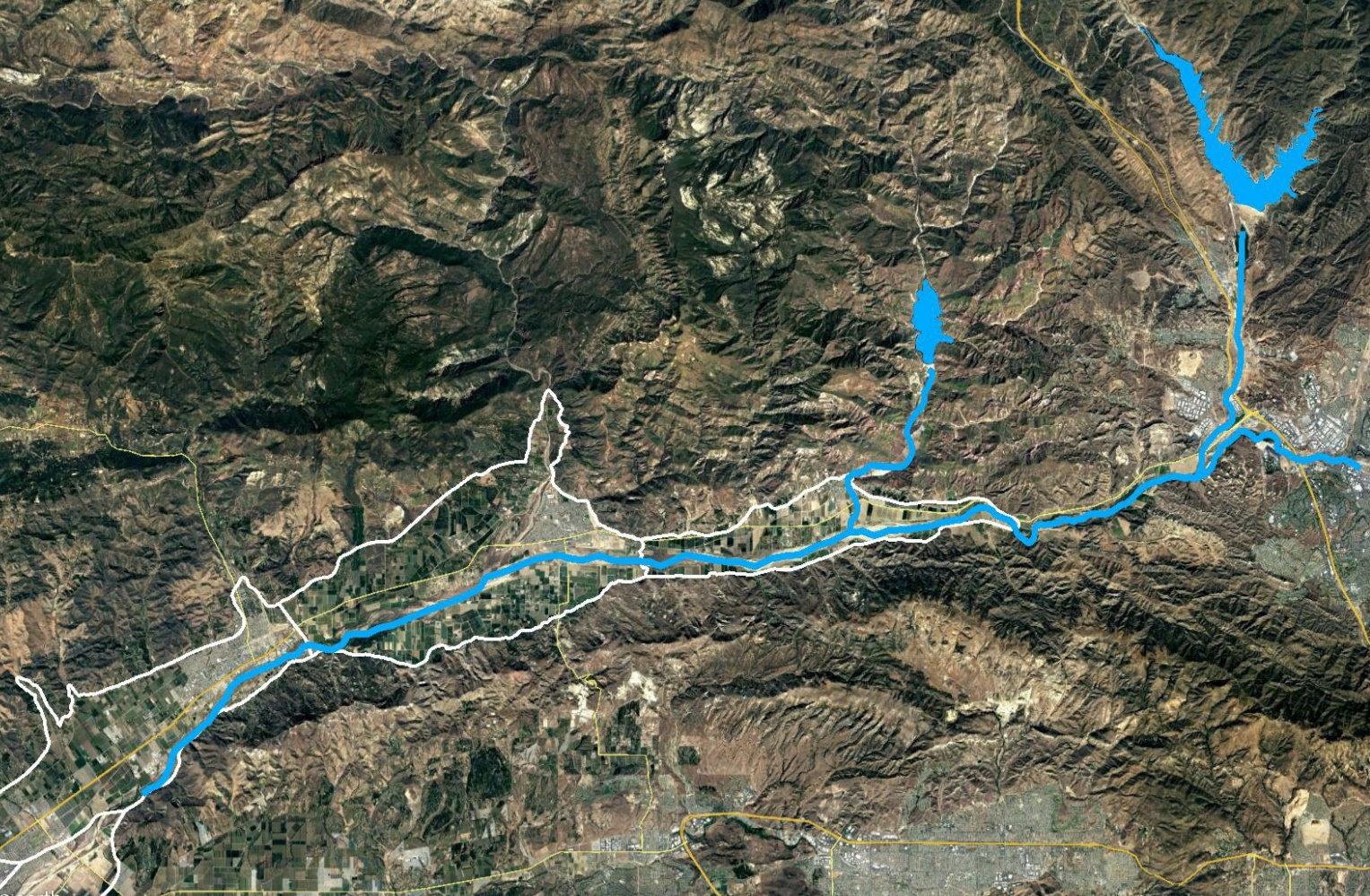
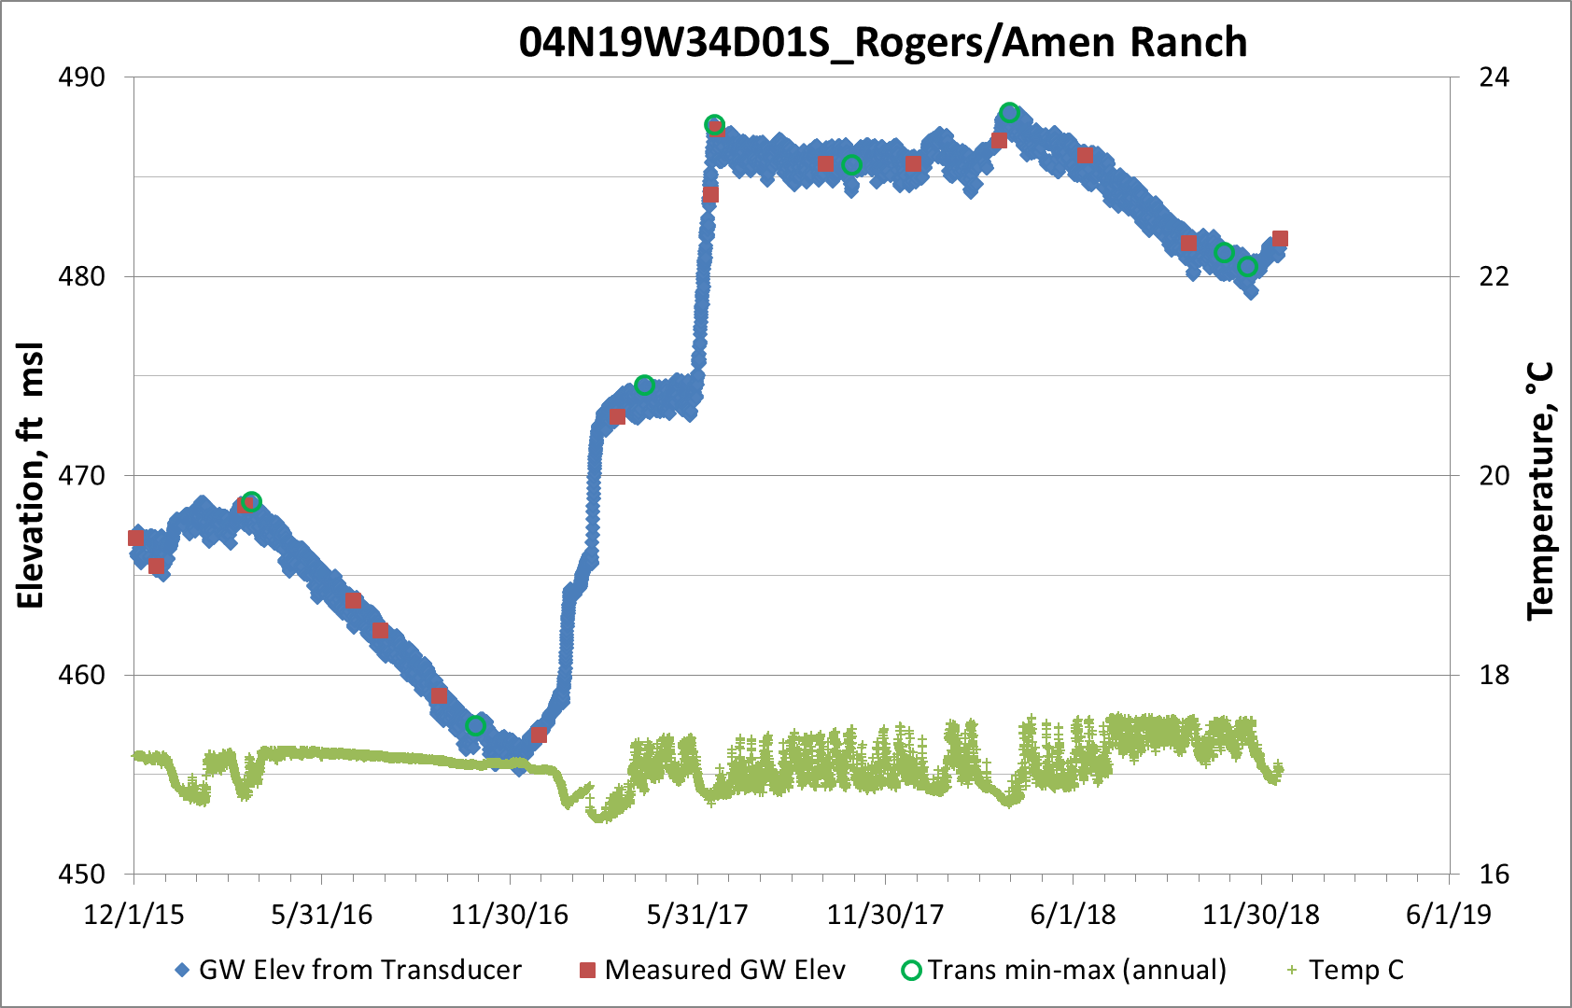
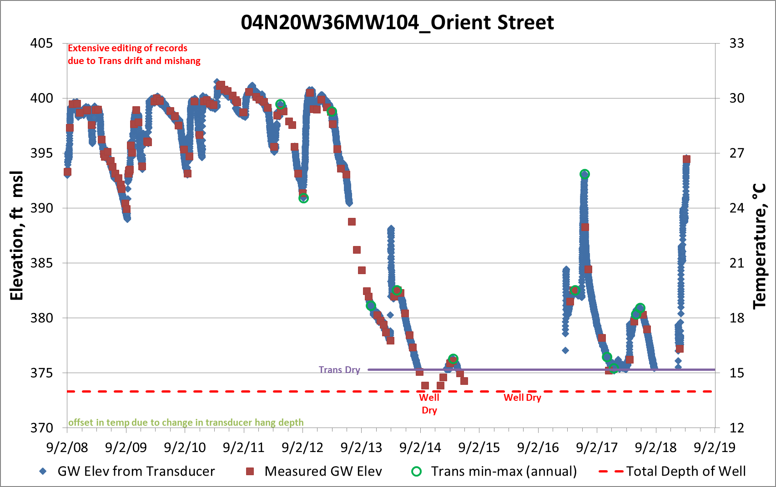
Conservation releases
Groundwater Levels have Increased
14 ft
40 ft
10 ft

Slide 15
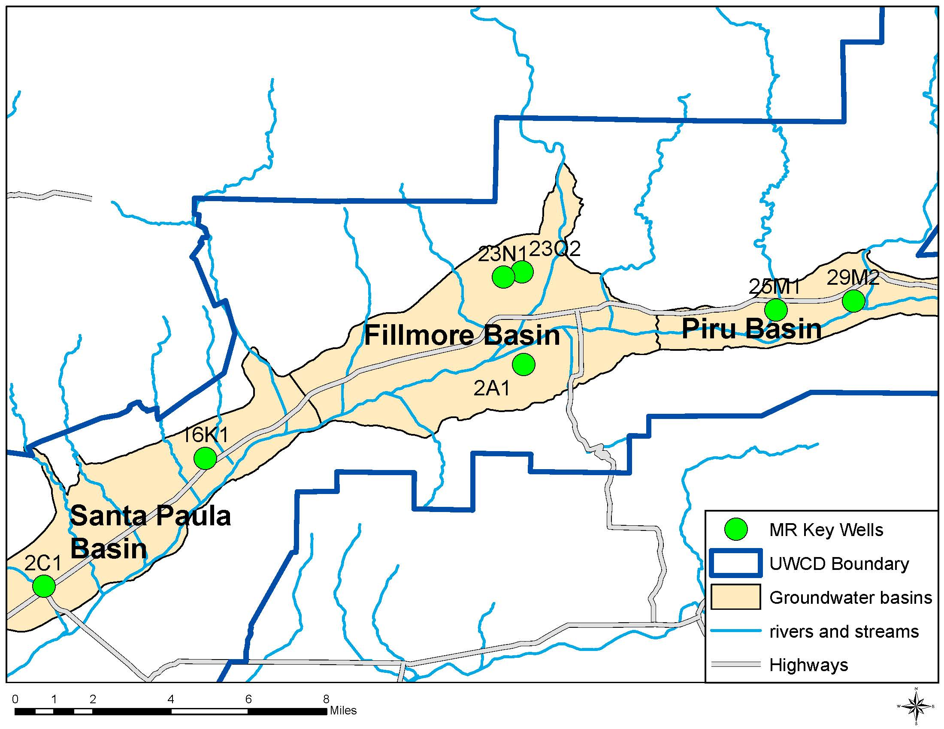
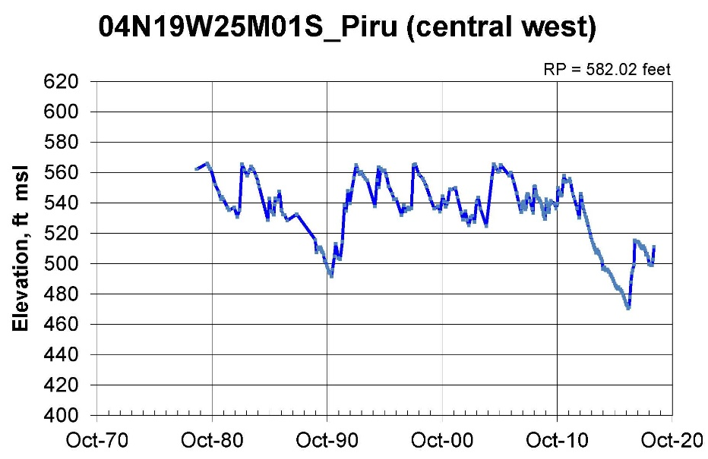
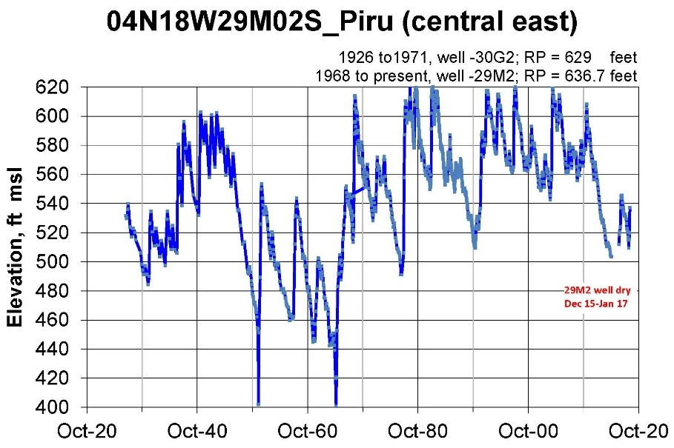

Slide 16
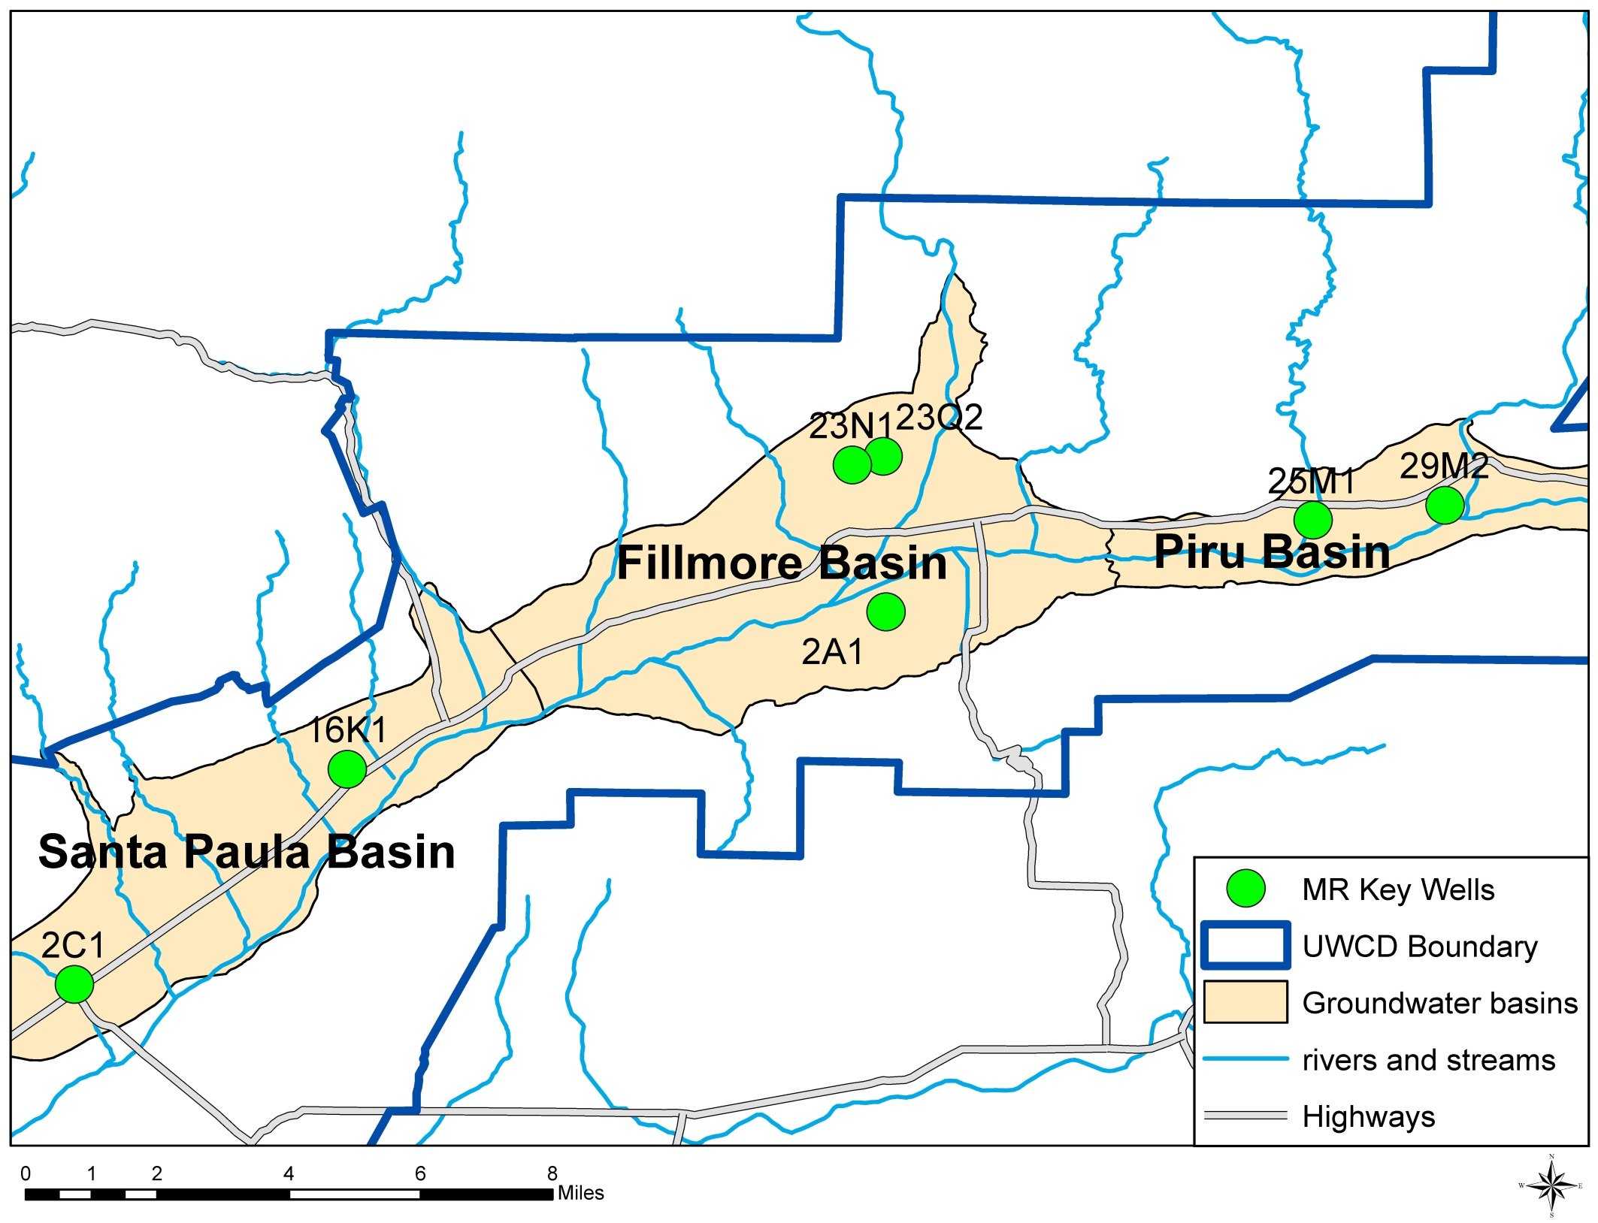
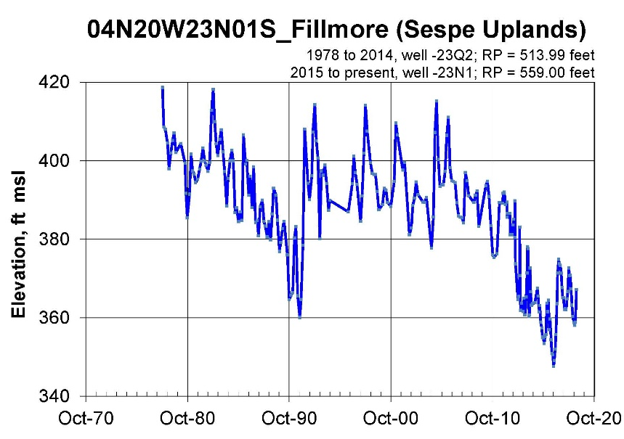
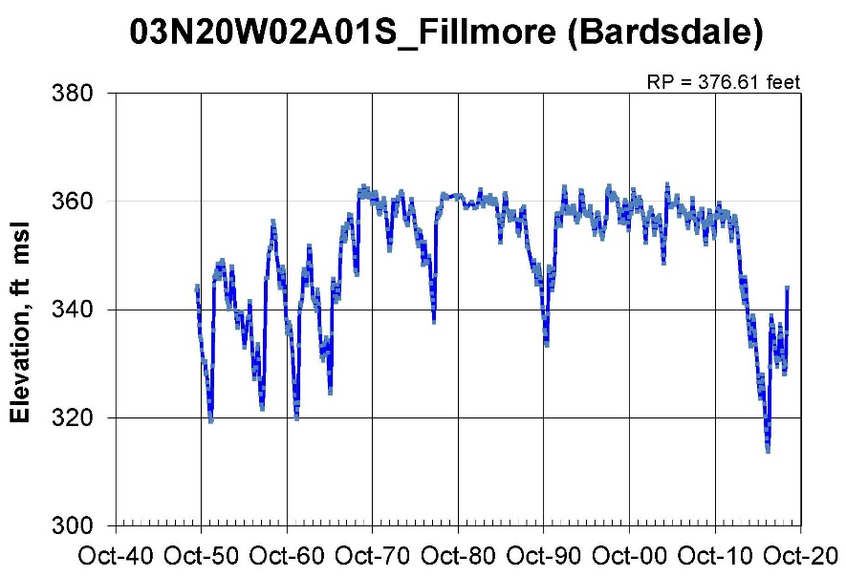

Slide 17
