Slide 1
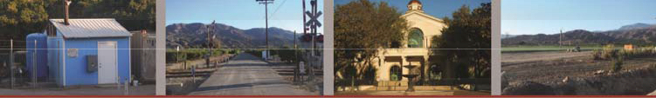
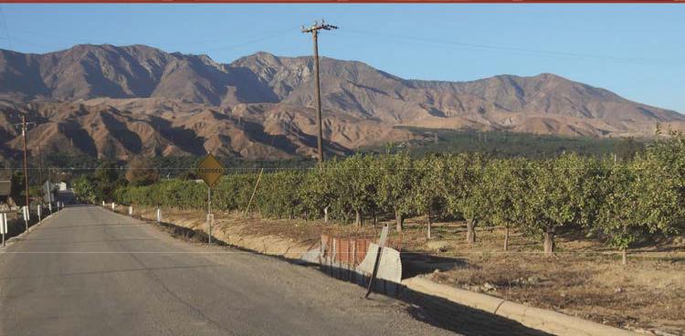
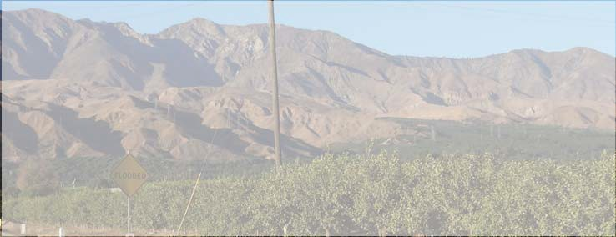

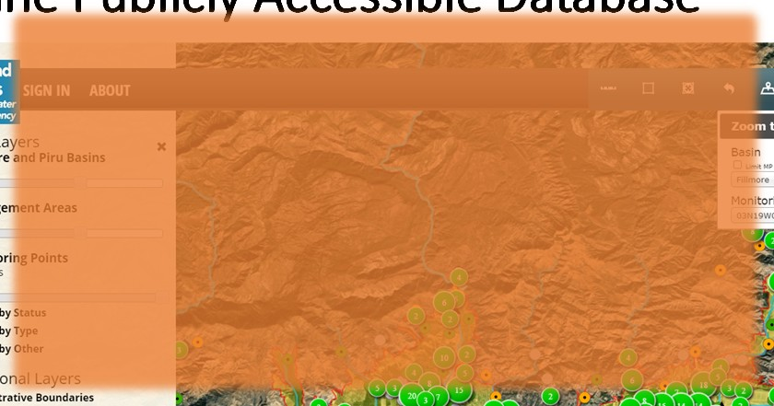
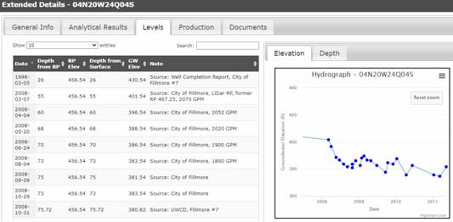
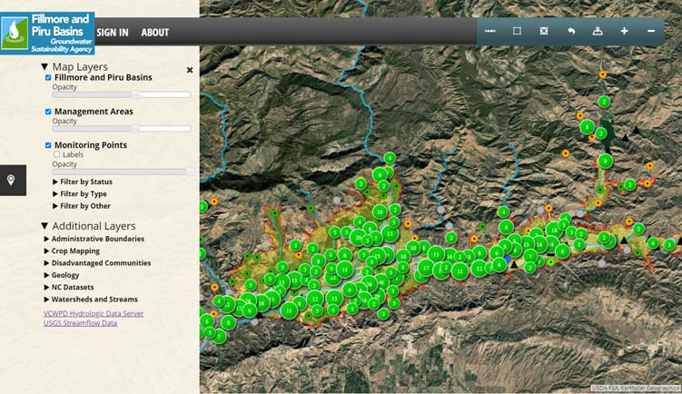
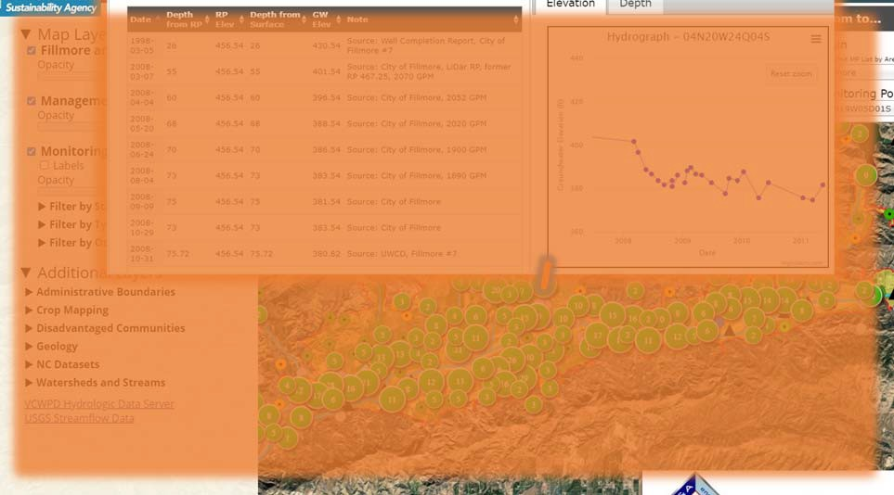
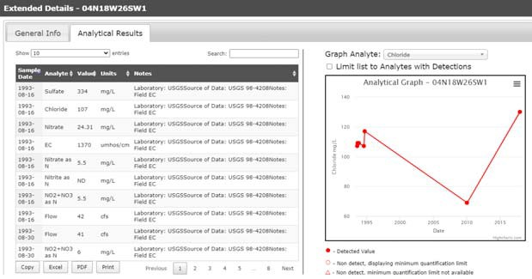




FPBGSA Board Meeting
6/26/2020
Hydrogeological Conditions
Fillmore and Piru Basins
Groundwater Sustainability Agency
Stakeholder Workshop
June 25, 2020
Online Publicly Accessible Database

Slide 2
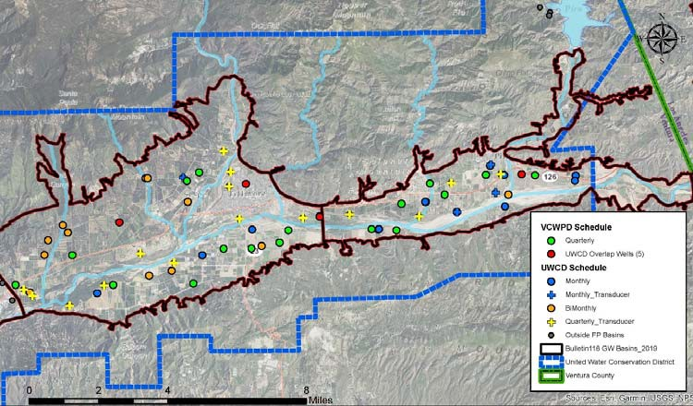

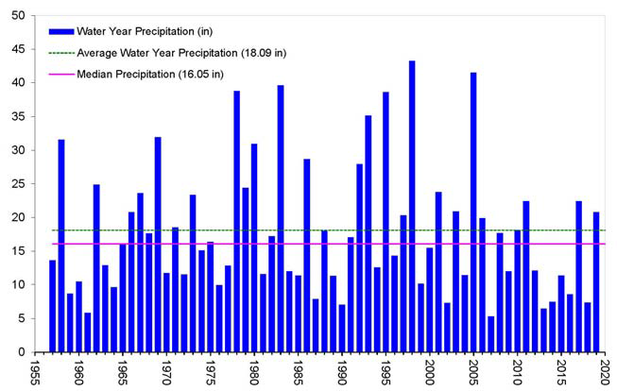

FPBGSA Board Meeting
6/26/2020
Water Level Monitoring Network
RAIN GAGE 171
Historical Annual Precipitation
WY through May
15.84 Inches 93% of Normal
Fillmore Fish Hatchery Rain Gage 171; Data from Ventura County Watershed Protection District
Precipitation (Inches)

Slide 3
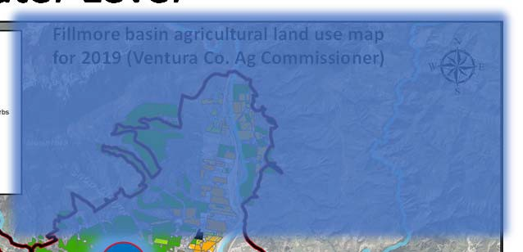
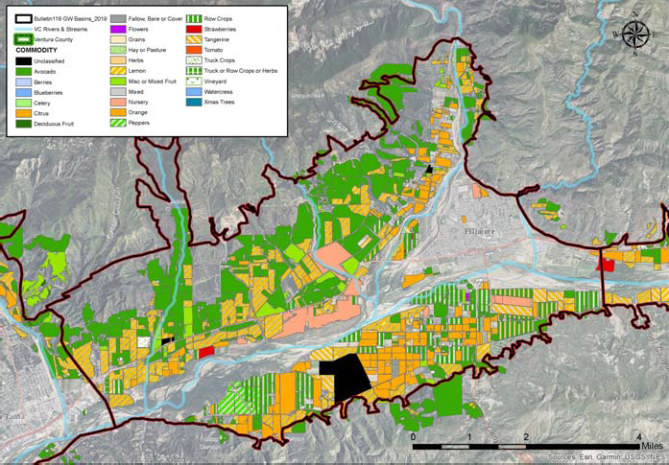
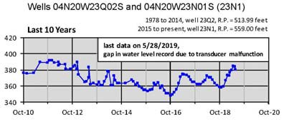
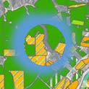
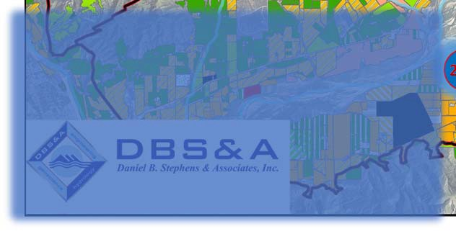
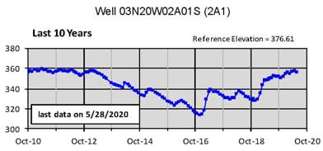
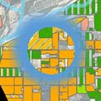
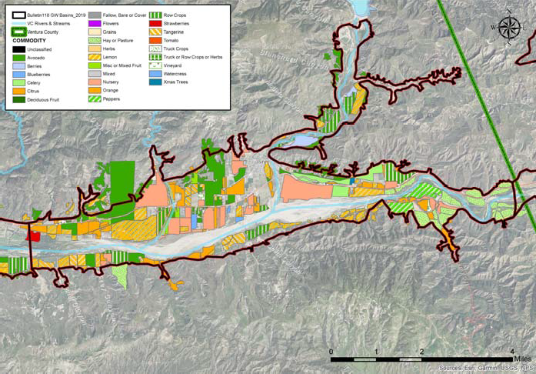
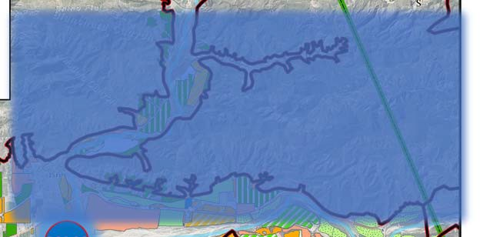
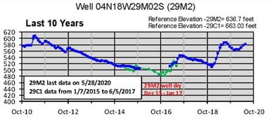

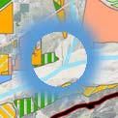
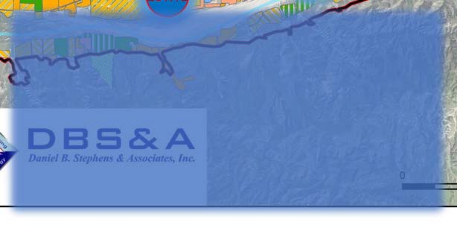
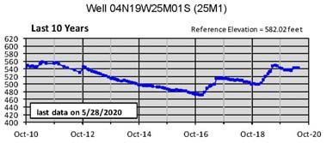
FPBGSA Board Meeting
6/26/2020
Fillmore Basin Water Level
23N1
1
Fillmore basin agricultural land use map for 2019 (Ventura Co. Ag Commissioner)
2A
Piru Basin Water Level
Piru basin agricultural land use map for 2019 (Ventura Co. Ag Commissioner)
29M2
25M1

Slide 4
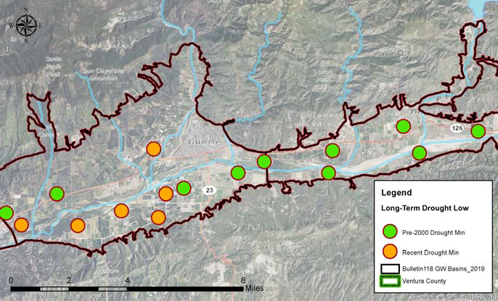

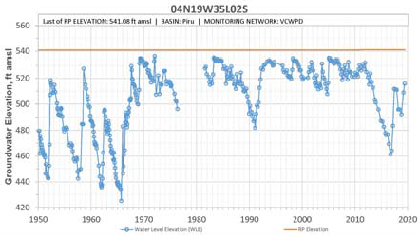

FPBGSA Board Meeting
6/26/2020
Drought Low Water Levels
DRAFT
35L2

